Slide 1
Children’s Internet Protection Act of 2000 (updated 2012)
Public Presentation
PTSA, November 4th, 2013

Slide 2
CIPA
Federal law, passed in 2000
Ensures safety of children accessing the Internet in schools & libraries
To receive federal funds, schools must be CIPA compliant
Annually, we receive funds from BOCES called eRate for technology communication services

Slide 3
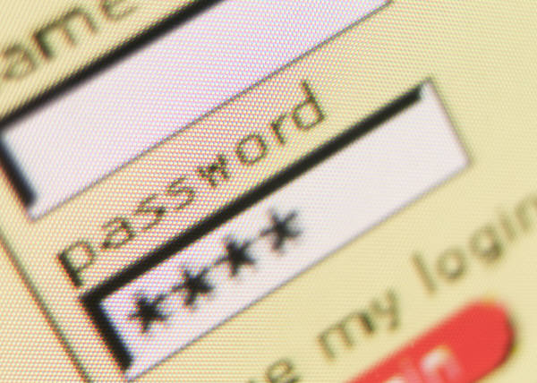
CIPA Requirements
Web filter on all machines connected to Internet
Block visual depictions that are pornographic, obscene, or harmful
Board approved policy
Educate users
Internet safety
Monitoring

Slide 4
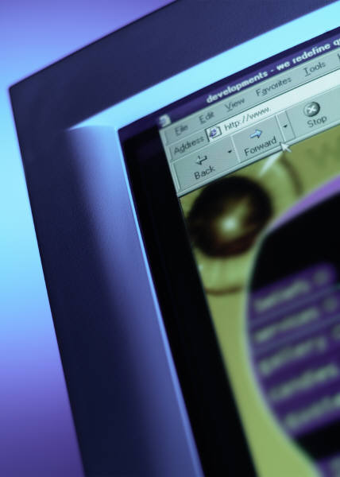
Newfane CSD Policy
Instructional Technology – 8270
Staff development for technology
Technology integration across curriculum
Equitable access
Budgeted funds for technology

Slide 5
Newfane CSD Policy
Internet Safety – 8271
Comply with CIPA
Educate students
Restrict access to unsafe sites
Monitor online activity
Ensure safety of students
Recognize best safety is proper supervision

Slide 6
Summary
Newfane CSD benefits from federal e-Rate funding and is CIPA compliant
NCSD adopted policies to support Internet safety and content filtering
Most of all, the safety of all children is the priority
Any questions or concerns, please contact me at 778-6352

