Slide 1
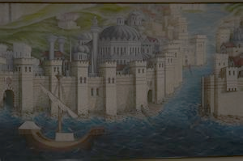
The Byzantine Empire and Early Russia
AP European History

Slide 2
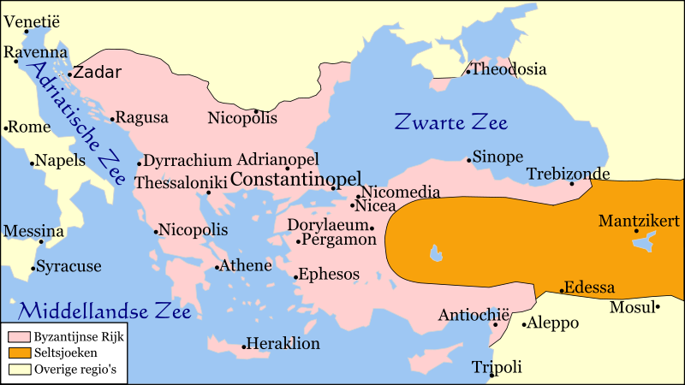
Byzantine Empire

Slide 3
Formation of the Empire
Established by Emperor Diocletian’s division of the Roman Empire
Eastern half of the Roman Empire
Constantine reunited the empires but moved the capital to Constantinople
Center of trade and commerce

Slide 4
Building the Empire
Justinian (527-565) nearly reunited the empires
Fought off a series of invasions – Huns, Slavs, Bulgars, Magyars & Muslims
Used diplomacy and military strength to build and protect Byzantium

Slide 5
Strengths of the Empire
Efficient civil service system
Well trained army
Strong economy
Emperor controlled the economy
Established a stable currency

Slide 6
Eastern Orthodox Church
Clergy considered state officials
Emperor appointed bishops
Greek was the language of the Church
1054 – officially split with the Roman Catholic Church

Slide 7
Heritage of Byzantium
Church of Santa Sophia was a blend of architectural styles
Preserved Greco-Roman culture
Justinian’s Code – law code based on Roman law

Slide 8
Decline of Byzantium
Weakened by civil wars
Attacks by Seljuk Turks
Constantinople sacked by Christian crusaders
1453 – Ottoman Empire captured Constantinople (Istanbul)

Slide 9
Early Russia – Heir to Byzantium

Slide 10
Land & People of Eastern Europe
Large flat plains with little protection
Several large rivers served as transportation routes– Danube, Dnieper
Populated by Slavic people
Cyril & Methodius – Greek monks – converted Slavs to Christianity
Used Greek letters to create a Slavic alphabet – Cyrillic Alphabet

Slide 11
Kievan Russia
800 – 900s city of Kiev emerged as a business & cultural center
Dnieper River connected Kiev to Constantinople
988 – Prince Vladimir order conversion of all Slavs to Byzantine Christianity
Adopted much of Byzantine culture

Slide 12
Decline of Kiev
Civil wars weakened power of Kiev in 1200s
Coincided with invasion by Mongols – Golden Horde
Russians forced to pay tribute
Cut Russia off from Constantinople – adopted Mongol customs
Commerce and industry disappeared

Slide 13
Rise of Muscovy
Princes of Moscow kept part of tribute collected for Mongols
1480 – Ivan III refused to pay tribute
Ivan established a strong central government
He married the niece of the last Byzantine emperor and took the title Czar
Ivan IV established a totalitarian state and kept strict control over nobles
Given the name Ivan the Terrible

